Slide 1

Intelligent Digital Law Firm Management System using Java
CSA0908-Programming in JAVA
PRESENTED BY:
P.Prasanna Sree(192324309)
Nandini M(192311417)
B. Ramya sri(192324262)
Guided By
Meganathan E

Slide 2


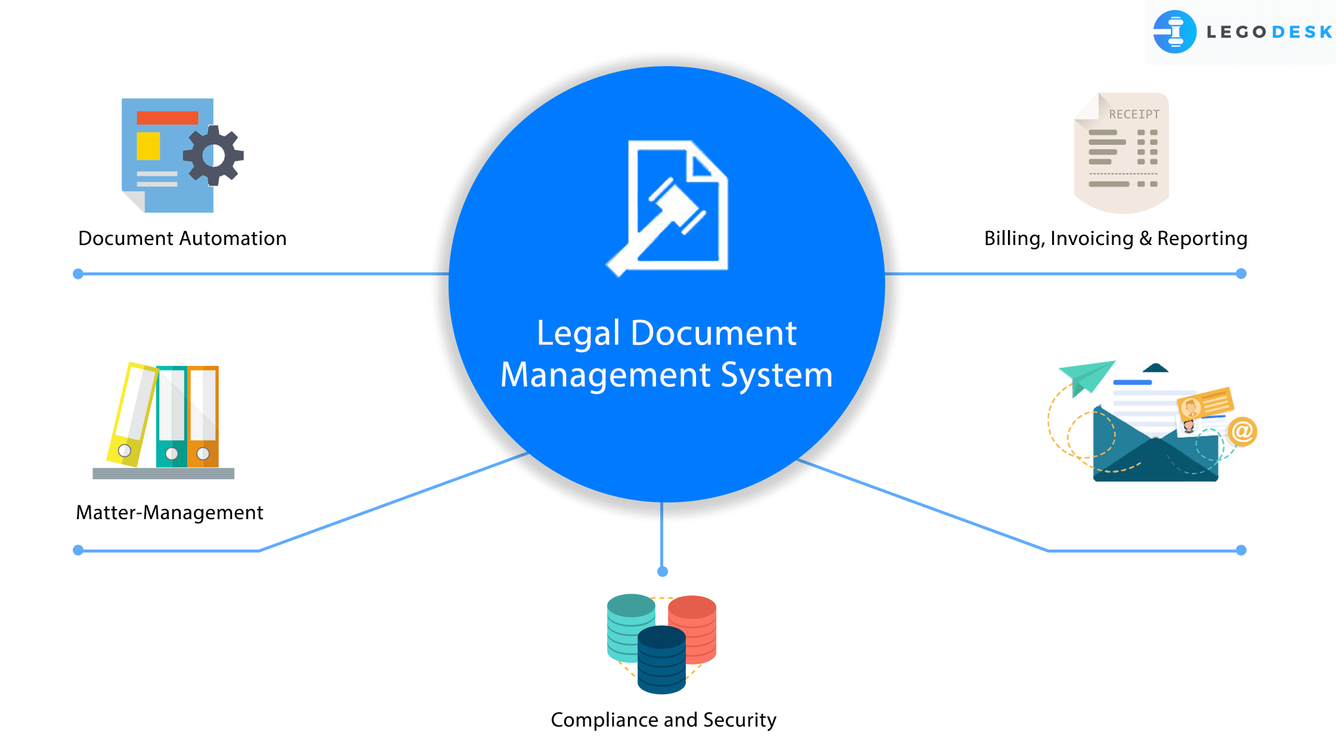
INTRODUCTION
Law firms handle large amounts of client, case, and legal document data.
Traditional manual systems are time-consuming and error-prone.
A digital management system helps automate legal operations.
Java technology provides a secure and scalable platform for development.

Slide 3
PROBLEM DEFINITION
Existing System Problems
Manual case management
Difficult document tracking
Time-consuming client communication
Risk of data loss
Poor appointment scheduling
Need for the System
Efficient case handling
Secure data management
Faster legal services
Improved productivity

Slide 4
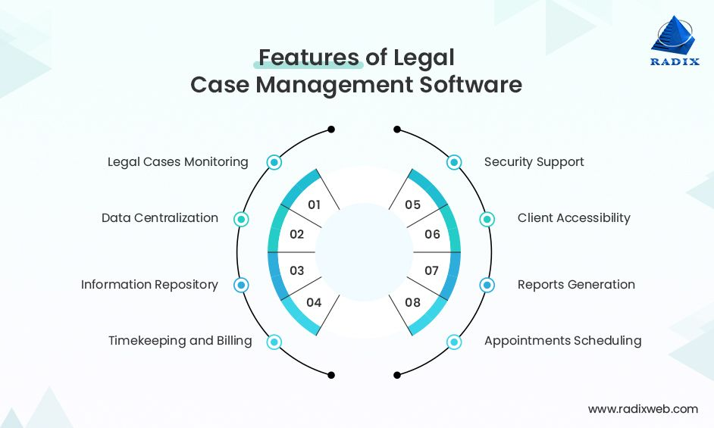
OBJECTIVES
Digitize law firm operations
Manage clients and legal cases efficiently
Automate appointment scheduling
Secure legal documents
Generate reports and analytics
Improve lawyer-client communication.

Slide 5
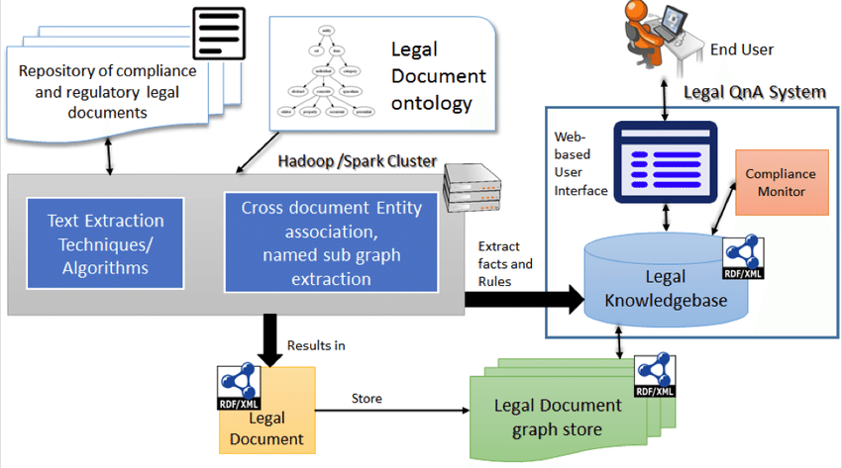
PROPOSED SYSTEM
The Intelligent Digital Law Firm Management System provides:
Client Management
Case Management
Lawyer Management
Document Storage
Appointment Scheduling
Billing & Payment Tracking
Report Generation

Slide 6
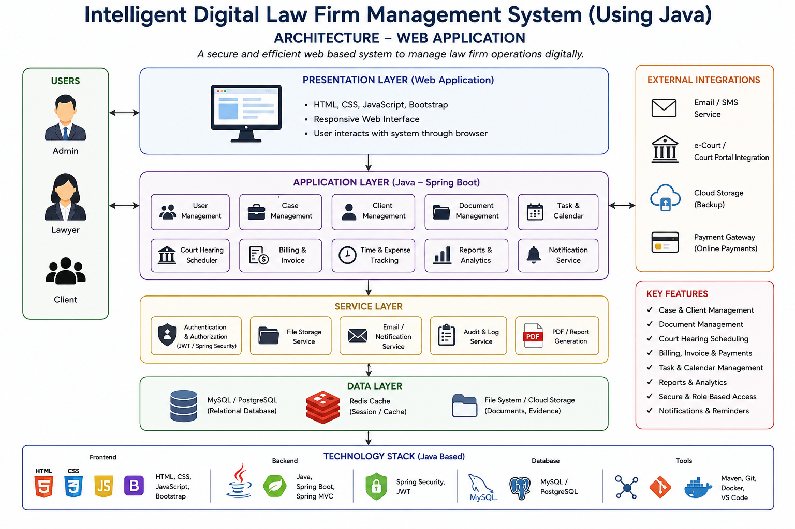
ARCHITECTURE

Slide 7
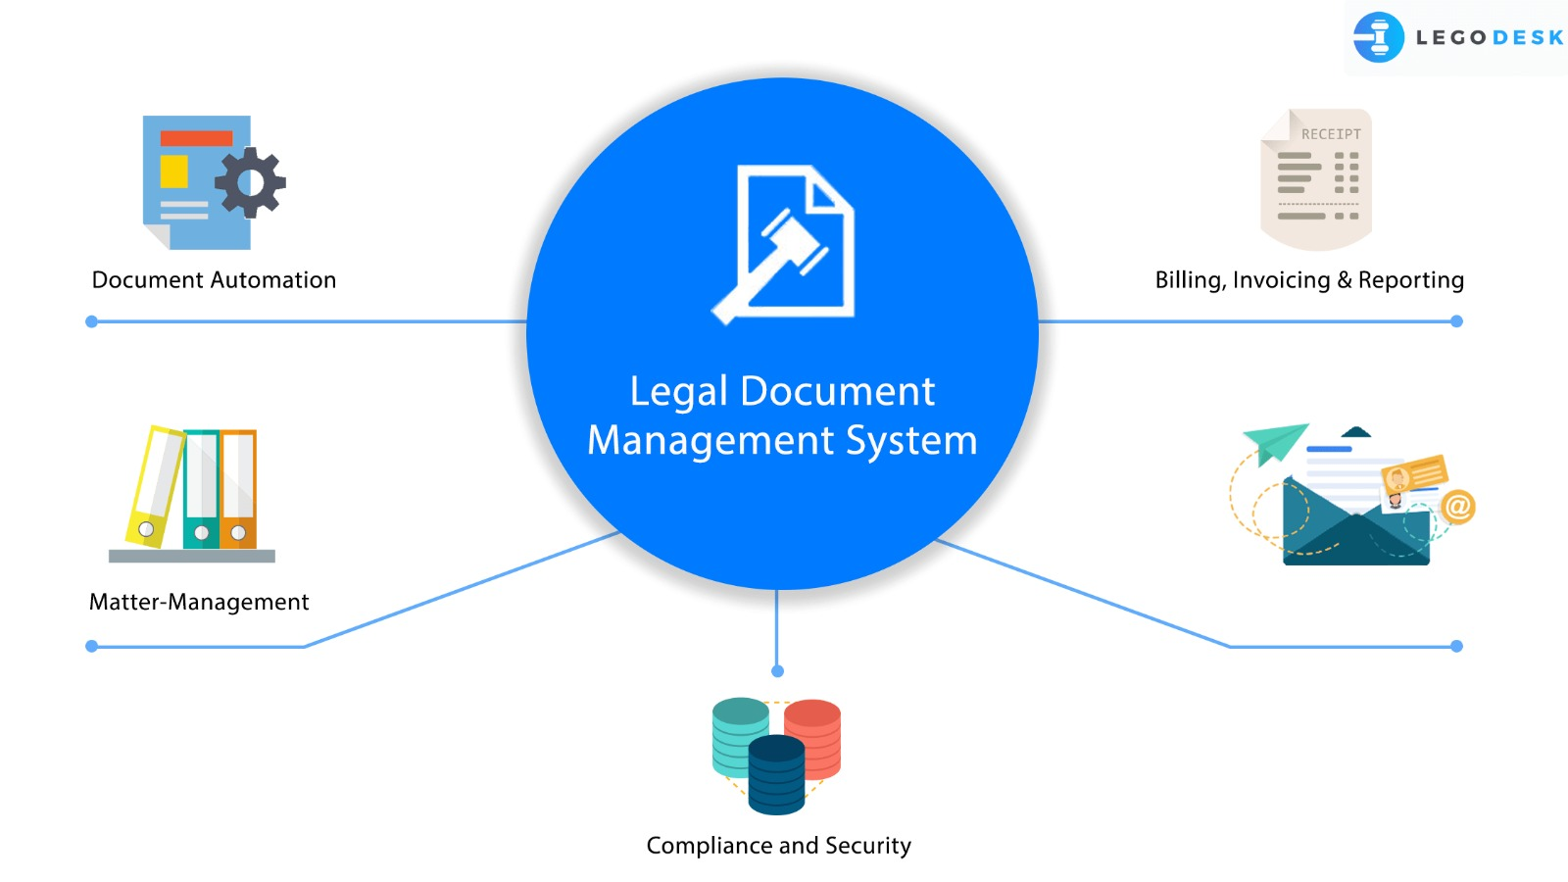
MODULE 1
Client Management Module
Functions:
Client registration and profile management
Store client information securely
Track client history and case details
Manage client appointments
Benefits:
Quick access to client records
Improved client communication

Slide 8
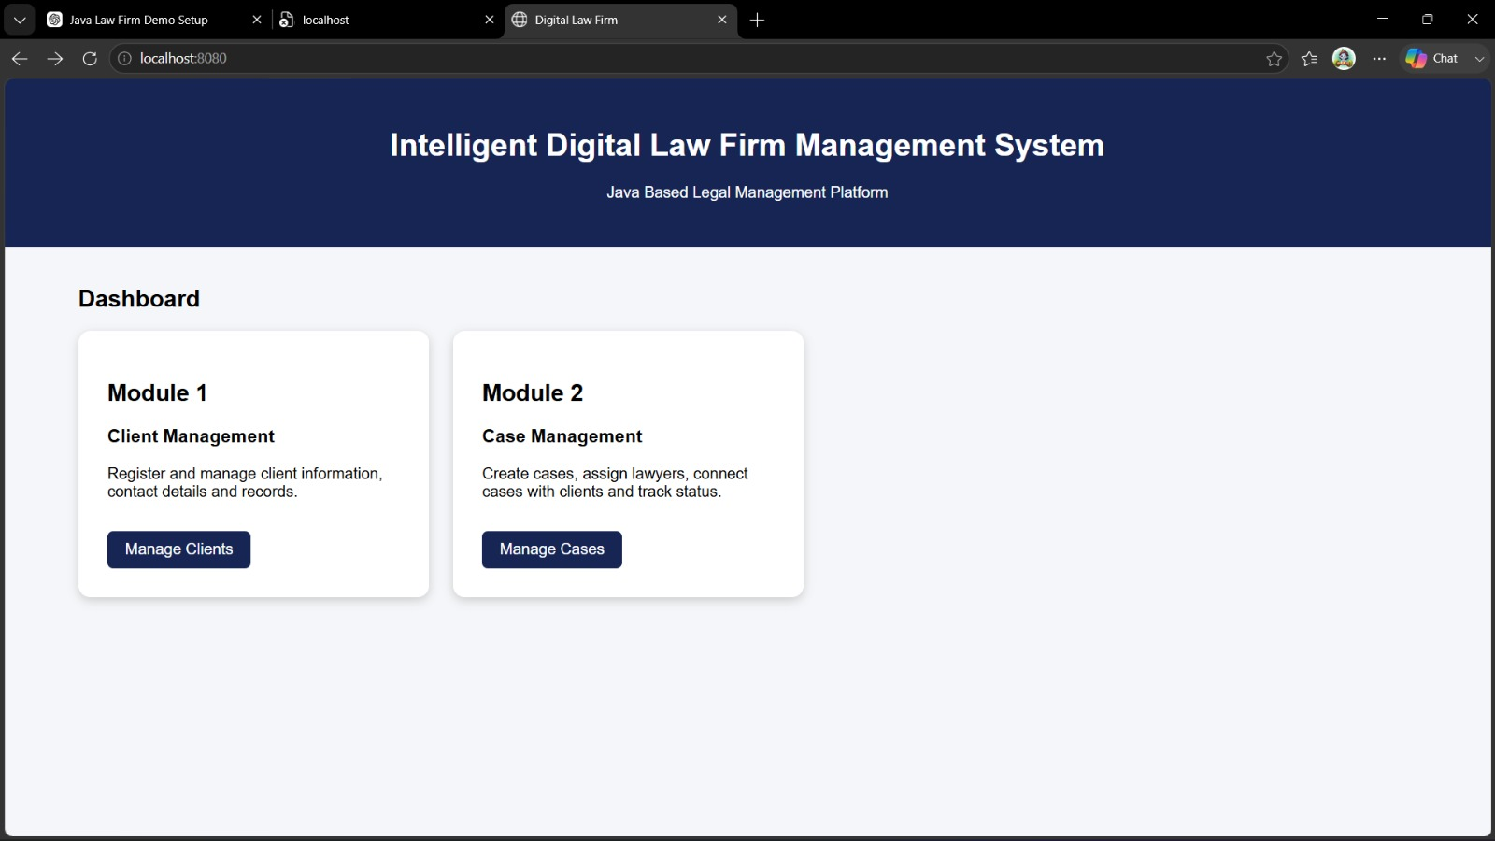

Slide 9
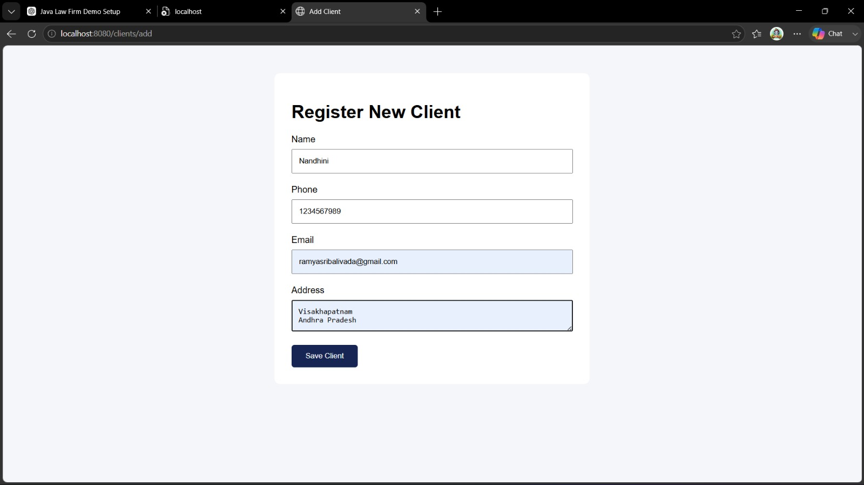

Slide 10
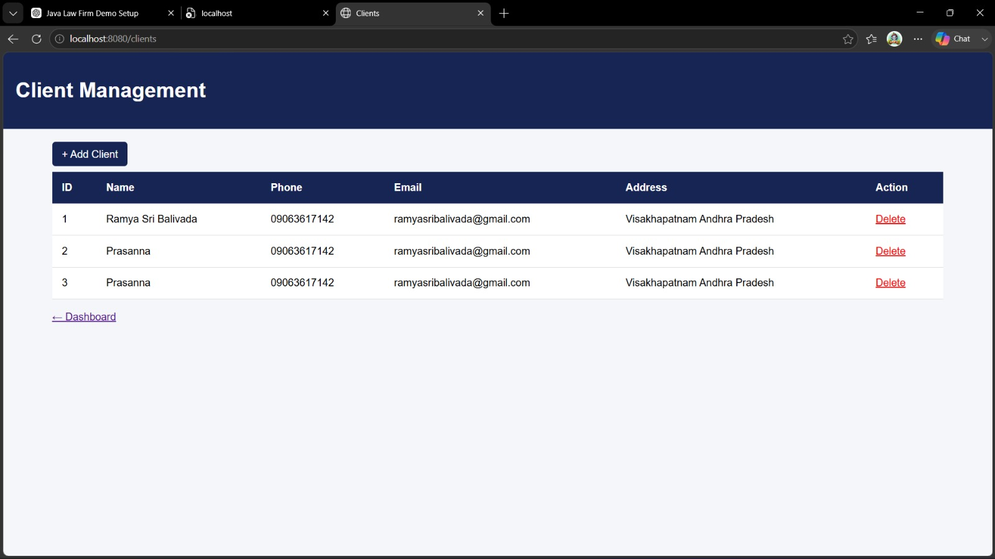

Slide 11
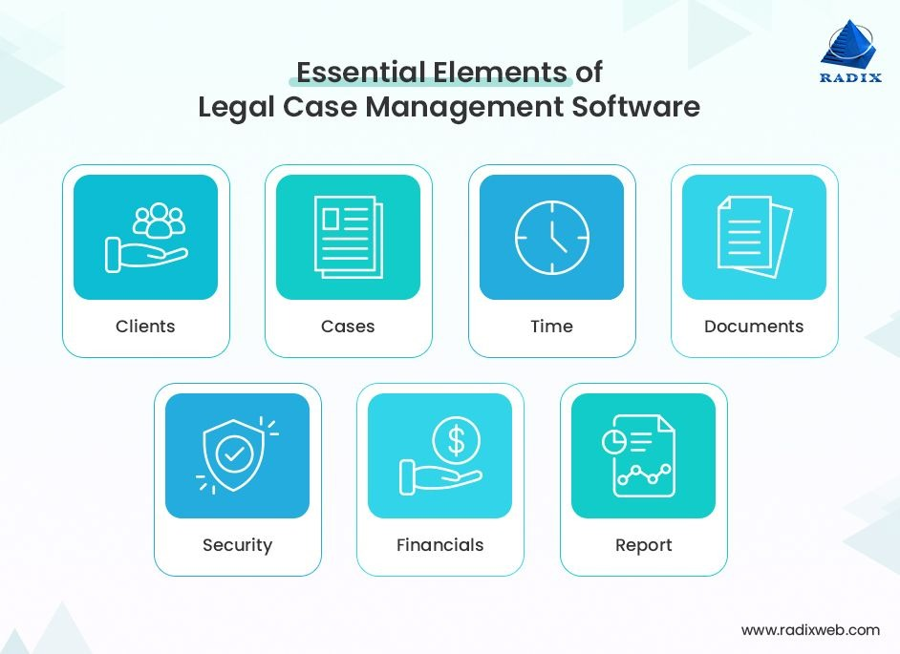
MODULE 2
Case Management Module
Functions:
Create and manage legal cases
Assign cases to lawyers
Update case status and progress
Store case-related documents
Benefits:
Better case tracking
Reduced paperwork
Efficient workflow management

Slide 12
MODULE 2
Case Management Module
Functions:
Create and manage legal cases
Assign cases to lawyers
Update case status and progress
Store case-related documents
Benefits:
Better case tracking
Reduced paperwork
Efficient workflow management

Slide 13
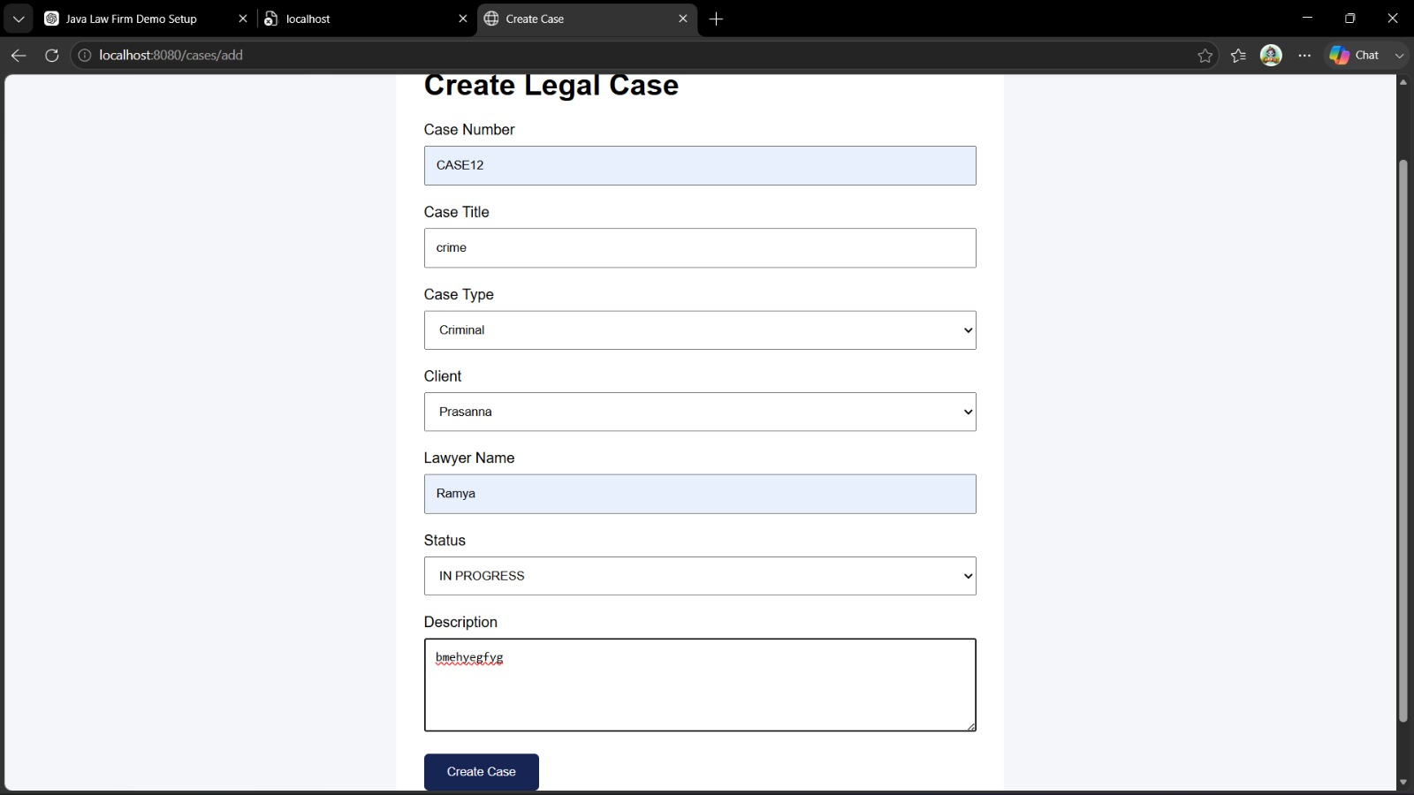

Slide 14
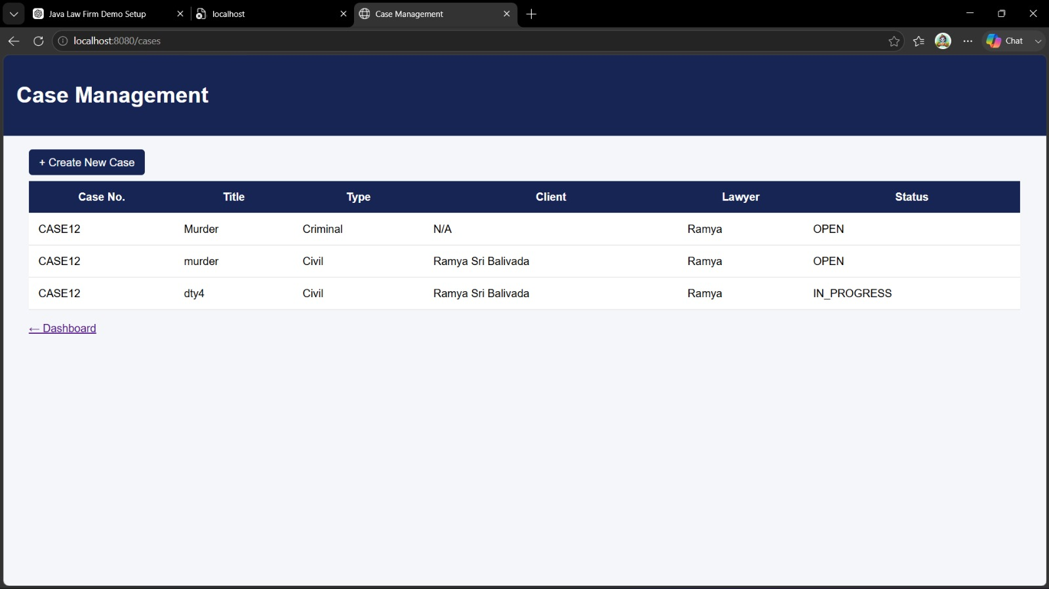

Slide 15
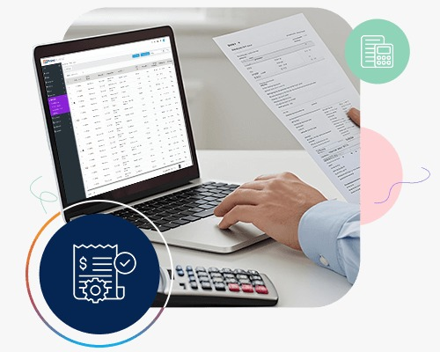
MODULE 3
Document & Billing Management Module
Functions:
Upload and manage legal documents
Generate invoices and bills
Track payments and transaction history
Generate financial reports
Benefits:
Secure document storage
Accurate billing process
Easy financial monitoring

Slide 16
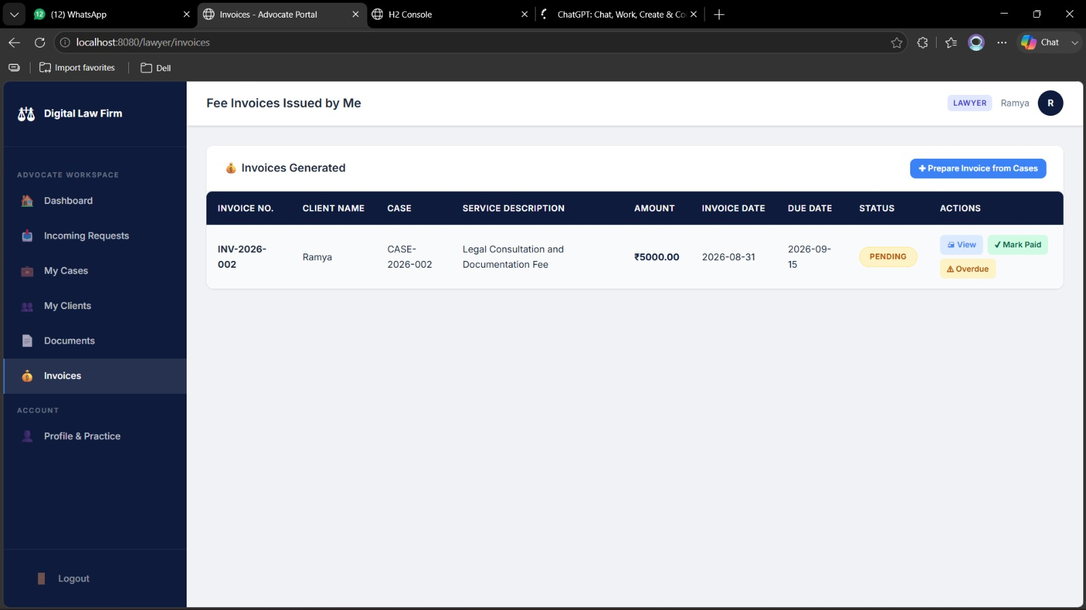

Slide 17
RESULT AND ANALYSIS
Successfully digitized client, case, and document management processes.
Reduced manual paperwork and administrative workload.
Improved accuracy in maintaining legal records and case information.
Enabled quick retrieval of client and case details.
Enhanced security through authenticated user access.
Streamlined appointment scheduling and case tracking.
Improved communication between lawyers and clients.
Generated reports and billing information efficiently.

Slide 18
CONCLUSION
Conclusion
The Intelligent Digital Law Firm Management System successfully automates the major activities of a law firm.
It provides efficient management of clients, cases, documents, and billing information.
The system reduces manual work, improves data accuracy, and enhances security.
Java and MySQL provide a reliable platform for developing a scalable legal management solution.
The project improves overall productivity and helps law firms deliver better services to their clients.

Slide 19
FUTURE SCOPE
Integration of Artificial Intelligence for legal research and case recommendations.
Development of a mobile application for lawyers and clients.
Cloud-based storage for secure access to legal documents from anywhere.
Implementation of chatbot support for client queries and appointment booking.
Advanced analytics and reporting for better decision-making.
Real-time notifications through email and SMS for case updates and appointments.
Multi-branch support for managing large law firms across different locations.

Slide 20


